Slide 1
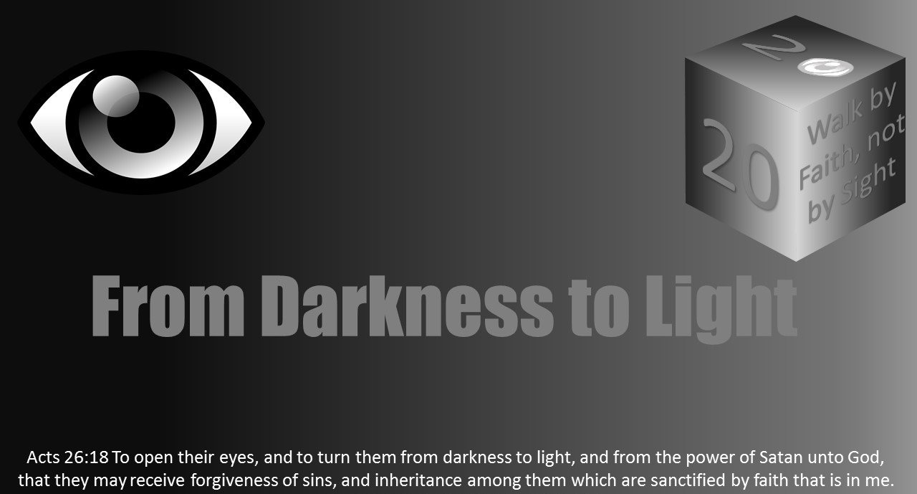


Slide 2
Light Lesson 14 Love - Powerful but Cannot See It

Slide 3
Introduction
On a stormy day, someone can make the statement “look at the wind!” As you look out the window you will see trees shaking and grass moving but where is the wind?
Love is like the wind. You can feel it and see the effects of it, but when it comes to using our physical eyes to see it, it has no form.
Love is powerful, but yet not “seen.”
Even though love is “the greatest of all” (1 Cor. 13:13), it seems to be missed and neglected so often by the world and sadly, even by us.

Slide 4
We cannot See It, but We Can Know It
We know love itself is not tangible. Can we see it? Can we taste or touch it?
So how then will we identify and practice love in our lives? Romans 5:6-8 - “For while we were still weak, at the right time Christ died for the ungodly. For one will scarcely die for a righteous person—though perhaps for a good person one would dare even to die— but God shows his love for us in that while we were still sinners, Christ died for us.”
1 John 3:16 - “By this we know love, that he laid down his life for us, and we ought to lay down our lives for the brothers.”

Slide 5
We cannot See It, but We Can Know It
Like all good things, love starts with Jesus.
If we are going to look to the Bible for the answers for identifying love in our lives, it will come from looking at Christ and His example.
Notice the two phrases in these passages about love, “God shows his love for us” and “by this we know love.”
Although we cannot see love, we can see Jesus; therefore, we can know love.
God “demonstrates” love by the life given by Jesus. And then as John says, this laying down of His life is how we can/do know love.

Slide 6
We cannot See It, but We Can Know It
Just as we can see the love God has for us by what He does, the rest of the world can see what we love by what we do.
“What does the world see me as a lover of?”
2 Timothy 3:1-4 - “But understand this, that in the last days there will come times of difficulty. For people will be lovers of self, lovers of money, proud, arrogant, abusive, disobedient to their parents, ungrateful, unholy, heartless, unappeasable, slanderous, without self-control, brutal, not loving good, treacherous, reckless, swollen with conceit, lovers of pleasure rather than lovers of God.”

Slide 7

We cannot See It, but We Can Know It
If lovers of self, money, and pleasure are not those who love God, then we can take the short step to conclude the inverse.
Those who are lovers of God do not seek themselves, do not let these things bog down their hearts, and are willing to deny the pleasures of this world for the sake of Jesus.
2 Timothy 3:5 - “having the appearance of godliness, but denying its power. Avoid such people.”

Slide 8
We cannot See It, but We Can Know It
Here is an example of how our eyes deceive us.
There are lovers of pleasure that “[appear godly]” yet do not love God.
But if we use the life of Jesus (and His death) as our template, we can see past the external and look at the heart of a person.

Slide 9
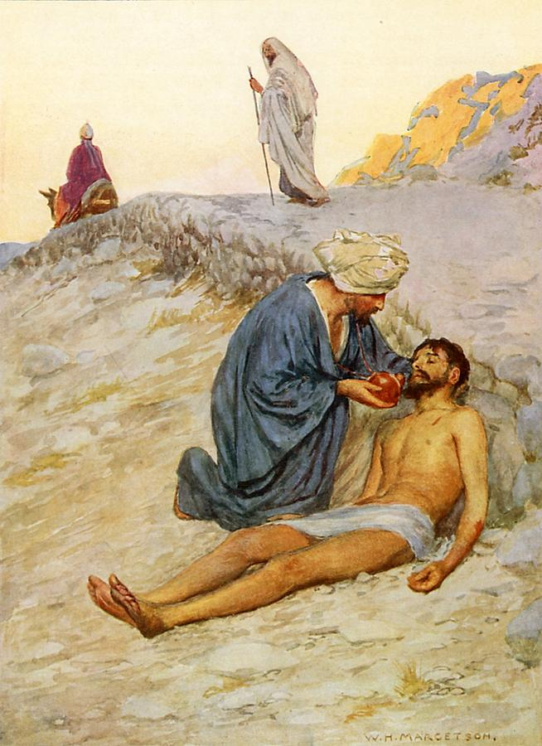
We cannot See It, but We Can Know It
Parable of the good Samaritan (c.f. Luke 10:25-37).
When the lawyer asks “Teacher, what shall I do to inherit eternal life?”
Jesus responds “What is written in the Law? How do you read it?”
The lawyer then replies “You shall love the Lord your God with all your heart and with all your soul and with all your strength and with all your mind, and your neighbor as yourself…
But [the lawyer], desiring to justify himself, said to Jesus, ‘And who is my neighbor?’”

Slide 10
We cannot See It, but We Can Know It
After Jesus tells the parable of the good Samaritan, He asked the question to the lawyer “Which of these three, do you think, proved to be a neighbor to the man who fell among the robbers?”
Was it the priest or the Levite? They would have certainly by physical characteristics appeared to be godly people.
Yet we can see the Samaritan, who by his physical characteristic (nationality) was not considered righteous, was the loving neighbor.
The lawyer also understood this fact.
He answered Jesus “the one who showed him mercy.’ And Jesus said to him, ‘You go, and do likewise.’”

Slide 11
We cannot See It, but We Can Know It
The command was to love your neighbor as yourself.
The word love was not mentioned in the parable, yet the lawyer (and us) can easily know the one who proved to be a neighbor was “the one who showed [the man who fell among the robbers] mercy.”
We as people can know whether or not someone is showing love.
Our love today as Christians can, should, and will be known by the mercy and grace we show to all who are our neighbors.
When love is who you are, it cannot help but be seen by those around you.

Slide 12
We cannot See It, but We Can Know It
1 John 4:7-9 - “In this the love of God was made manifest among us, that God sent his only Son into the world, so that we might live through him.”
The same love Jesus shows us and fills us with is the love we too can “manifest” in our lives in order to help others see it. The fact love is strong enough to be observed is in itself a “powerful” characteristic.

Slide 13

What Is Love?
Many people have tried to describe love and to understand it.
I think none of us could possibly do it better than the inspired apostles did.
Love Defined - 1 Corinthians 13
Love Exemplified - Philippians 2:3-8
Love Characterized - 1 John 4:7-21
There is a lot of reading there but considering Love is the greatest of all it is well worth the extra time spent. The actions that are/come from love tend to not come naturally to human nature.

Slide 14
Everything is Nothing Without Love
When it comes to powerful things throughout history, we could list the tongue as one of the most powerful.
James in James 3 describes the tongue as something so small yet so powerful, comparing it to a small fire which can burn down a whole forest.
It has been the catalyst of revolutions, civil wars, and many other conflicts through history.
But when it comes to the things of God, the tongue is not much without love.

Slide 15
Everything is Nothing Without Love
Paul in 1 Corinthians 13:1-3 lists it among other things saying, “If I...”
“Speak in the tongues of men and of angels”
“Have prophetic powers, and understand all mysteries and all knowledge,
and if I have all faith, so as to remove mountains”
“Give away all I have, and if I deliver up my body to be burned”
But follows each statement with “but have not love...”
“I am a noisy gong or a clanging cymbal”
“I am nothing”
“I gain nothing”

Slide 16
Everything is Nothing Without Love
Love, when it comes to God and the things pertaining to God, love is everything!
Perhaps that is because “God is love” (1 John 4:8).
When we start doing things without love being the motive, we start veering away from the gospel.
Consider Paul’s admonishment to “speak the truth in love” to help one another grow in Christ (Eph 4:15).
Love is powerful indeed if other good things are rendered useless when not accompanied by love.

Slide 17
Love Saves Us from Ourselves
One way of measuring power could be the ability of something to overcome something else.
For example, a side of a mountain is overcome by dynamite as its “power” brings it down.
As Christians, we strive to be like Christ, but the problem is there are things in our lives, which are ingrained into who we are and make us different than who Christ is.
What we need is something powerful enough to help us overcome it.
Enter love.

Slide 18
Love Saves Us from Ourselves
Let’s look at two conflicting forces.
1 John 2:15 - “Do not love the world or the things in the world. If anyone loves the world, the love of the Father is not in him.”
The very nature of the love of God is to be selfless; however, the love of the world is selfishness. Or as stated later in the verse “For all that is in the world—the desires of the flesh and the desires of the eyes and pride of life—is not from the Father but is from the world” (1 John 2:16).

Slide 19
Love Saves Us from Ourselves
The love of the world and things in the world is powerful.
I believe we are all living examples to confirm this.
How many times has our will power failed us when it comes to our diet, exercise, study, or ____ (insert your issue here) goals? How many times have we said “I am going to quit ____” and then not quit it?
These are just the symptoms of the real problem, US.
We eat chocolate cake because WE like it.
Perhaps the verse says, “If anyone loves the world, the love of the Father is not in him” because when the love of God is perfected in us, there is no room for selfish love because they are in themselves opposites.
That’s what all of us need to overcome ourselves, love.

Slide 20
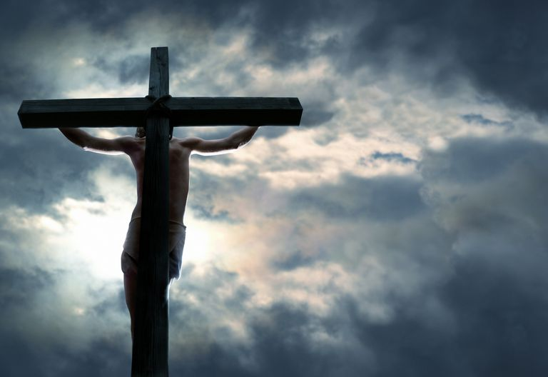
Love Saves Us from Ourselves
Paul writes contrasting selfishness and selflessness.
Philippians 2:3-8 - “Do nothing from selfish ambition or conceit, but in humility count others more significant than yourselves. Let each of you look not only to his own interests, but also to the interests of others. Have this mind among yourselves, which is yours in Christ Jesus, who, though he was in the form of God, did not count equality with God a thing to be grasped, but emptied himself, by taking the form of a servant, being born in the likeness of men. And being found in human form, he humbled himself by becoming obedient to the point of death, even death on a cross.”

Slide 21
Love Saves Us from Ourselves
We learn love by Jesus, namely His example.
An almighty God in the perfection of Heaven comes to earth with full knowledge of the pain and humiliation he would face in life and in death.
What possibly would have the power to remove Jesus – He who made all creation, from heaven to earth?
Nothing except the power of love (c.f. John 1:1-5).
And that is our cure for the disease of selfishness; the love of God. N
ow that is powerful – something which would make us want to remove ourselves from our thoughts and replace it with others.

Slide 22
Love and the Gospel
Considering the fact God is love, it is not surprising it would be the defining characteristic of the gospel.
1 Corinthians 15:1-4 - “Now I would remind you, brothers, of the gospel I preached to you, which you received, in which you stand, and by which you are being saved, if you hold fast to the word I preached to you—unless you believed in vain. For I delivered to you as of first importance what I also received: that Christ died for our sins in accordance with the Scriptures, that he was buried, that he was raised on the third day in accordance with the Scriptures.”

Slide 23
Love and the Gospel
Jesus died. Jesus was buried. Jesus was raised from the dead.
These things are the gospel. Taking a second glance at a verse we looked at earlier, reference 1 John 3:16.
The gospel is our example of knowing love.
But why is dying such an act of love? Again, reference a previously discussed Rom 5:6-8. It is because the gospel saves us. Similar to taking a bullet for someone (i.e., die for someone), you have “saved” them.
Romans 1:16 - “For I am not ashamed of the gospel, for it is the power of God for salvation to everyone who believes, to the Jew first and also to the Greek.”

Slide 24
Love and the Gospel
Talk about powerful. It has the ability to save someone and to preserve a life.
Or perhaps more specifically in the case with us and the gospel, it does not save us in the sense in which we do not die (physically), but rather we are saved in the sense in which we will die but yet be raised from the dead.
Raising someone from the dead is a power, reserved only for God. It is a power unattainable by anyone else without Him.

Slide 25
Love and the Gospel
Not only is the gospel founded on love, but love is how it is spread. Look at this passage in Ephesians.
Ephesians 4:15 - “Rather, speaking the truth in love, we are to grow up in every way into him who is the head, into Christ.”
If we are going to spread the gospel, our message be love but also spoken in love to the recipients. Take this verse from 1 John.
1 John 4:20 - “If anyone says, “I love God,” and hates his brother, he is a liar; for he who does not love his brother whom he has seen cannot love God whom he has not seen.”

Slide 26
Love and the Gospel
The very essence of the example of Jesus is sacrificing yourself for people who do not know you. That is how God’s message will be spread.
If a group of Christians is all about the truth but does not show love, they undermine the gospel. God is then mocked by those who see them. They may say “They call themselves ‘Christians,’ yet they are mean and rude and think only of themselves.”
If we are going to be the lights in the world that God needs us to be, then we will show the love of God because love defines God’s people.
John 13:35 - “By this all people will know that you are my disciples, if you have love for one another.”
Love has everything to do with the gospel; and thereby, love has everything to do with us.

Slide 27
Conclusion
We all need more love (that is the love for God and the Love from God).
Even though it is not seen with the eye, it can still be sought after with all your strength using your heart, soul, and mind (Luke 10:27).
Therefore, let us seek the love of God and strive to serve one another rather than ourselves.
And, the power of this love will completely change our lives for the better. Amen.

